Slide 1

NIPA Covid-19 Paper and Government / Inspectorate update

Slide 2

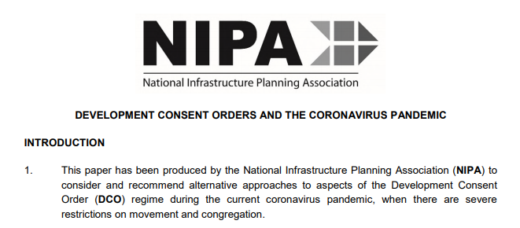

NIPA MATTERS
27 July 2020
NIPA produced a paper entitled Development Consent Orders and the Coronavirus Pandemic on 21 April 2020 and submitted it to the government and the Planning Inspectorate

Slide 3
NIPA MATTERS
27 July 2020
Topics covered:
Documentation
Consultation and engagement
Hearings
Site access
Implementation

Slide 4
NIPA MATTERS
27 July 2020
Recommendation progress:
No. | Topic | Addressed?
1 | Waiver power | Not yet
2 | Planning Aid funding | Not yet
3 | Online-only inspection | Yes
4 | Updated guidance | Yes
5 | Updated advice | Only EIA so far
6 | Site notice waiver | No
7 | Service requirements | In guidance
8 | CA online-only inspection | Yes
9 | Advice to LAs on SoCC | Not yet

Slide 5
NIPA MATTERS
27 July 2020
Recommendation progress:
No. | Topic | Addressed?
10 | SoCC hard copy inspection | In guidance
11 | Hearings law | Not yet
12 | Hearings procedure advice | Not yet
13 | Hearings venue advice | Not yet
14 | Site surveys permissible | Not yet
15 | Environmental mitigation | Not yet
16 | Site inspections | Not yet
17 | Extensions to DCOs | No
X | Site surveys unrepresentative | In guidance

